Slide 1
NLP from Scratch
PEIYANG SONG
Ccs computing ‘26
CMPTGCS 1L Fall 2022

Slide 2
Brief overview
Let’s jump to the Github page!

Slide 3
Paper structure

Slide 4
Paper structure
Gives brief introduction after the title and the abstract.
01
Describes the benchmark tasks of interest.
02
Describes the unified model and reports benchmark results obtained with supervised training
03
04
05
06
Leverages large unlabeled data sets (~ 852 million words) to train the model on a language modeling task
Investigates multitask supervised training
Evaluates how much further improvement can be achieved by incorporating standard NLP task-specific engineering into our systems

Slide 5
About title & abstract

Slide 6

About title & abstract
Natural Language Processing

Slide 7


About title & abstract
Natural Language Processing
Extract simpler representations that describe limited aspects of the textual information
Those representations are often motivated by specific applications (e.g. part-of-speech tagging) or by our belief that they capture sth. more general about natural language (e.g. word-sense disambiguation)
In short, syntactic information & semantic information
Try to excel on multiple benchmarks while avoiding task-specific engineering
Instead, a single learning system is used, which is able to discover adequate internal representations
Prevent us from using a large body of linguistic knowledge, but transfers intermediate representations discovered on large unlabeled data sets
TO

Slide 8

About title & abstract
Natural Language Processing
From “Scratch”

Slide 9
About title & abstract
Natural Language Processing
From “Scratch”
· Reduced reliance on previous NLP knowledge
· Instead, we use a multi-layer neural network architecture
· It takes the input sentence and learns several layers of feature
extraction that process the inputs
· The features computed by the deep layers of the network
are automatically trained by backpropagation to be relevant
to the task
· This will be a general multi-layer architecture suitable for all our
NLP tasks, which is generalizable to other NLP tasks as well.

Slide 10
NLP from Scratch
PEIYANG SONG
Ccs computing ‘26
CMPTGCS 1L Fall 2022

Slide 11
Brief review
Github page & readme.md
Structure of paper & presentation
Title & abstract

Slide 12
About title & abstract
Natural Language Processing
Extract simpler representations that describe limited aspects of the textual information
Those representations are often motivated by specific applications (e.g. part-of-speech tagging) or by our belief that they capture sth. more general about natural language (e.g. word-sense disambiguation)
In short, syntactic information & semantic information
Try to excel on multiple benchmarks while avoiding task-specific engineering
Instead, a single learning system is used, which is able to discover adequate internal representations
Prevent us from using a large body of linguistic knowledge, but transfers intermediate representations discovered on large unlabeled data sets
TO

Slide 13
About title & abstract
Natural Language Processing
From “Scratch”
· Reduced reliance on previous NLP knowledge
· Instead, we use a multi-layer neural network architecture
· It takes the input sentence and learns several layers of feature
extraction that process the inputs
· The features computed by the deep layers of the network
are automatically trained by backpropagation to be relevant
to the task
· This will be a general multi-layer architecture suitable for all our
NLP tasks, which is generalizable to other NLP tasks as well.

Slide 14

About title & abstract
Natural Language Processing
From “Scratch”
Deep Learning
-> “NLP from Scratch”

Slide 15




Benchmarks
There are basically four benchmarks,
each testing for a traditional NLP task.
Part-Of-Speech Tagging
(POS)
Chunking
(i.e., Shallow parsing)
(CHUNK)
Named Entity Recognition
(NER)
Semantic Role Labeling
(SRL)

Slide 16
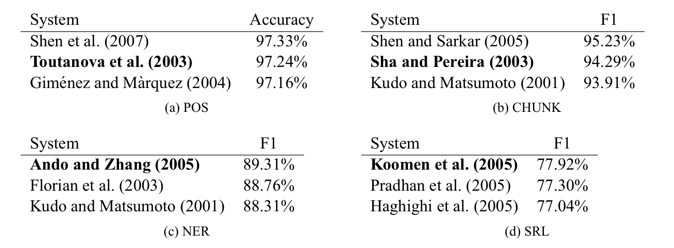
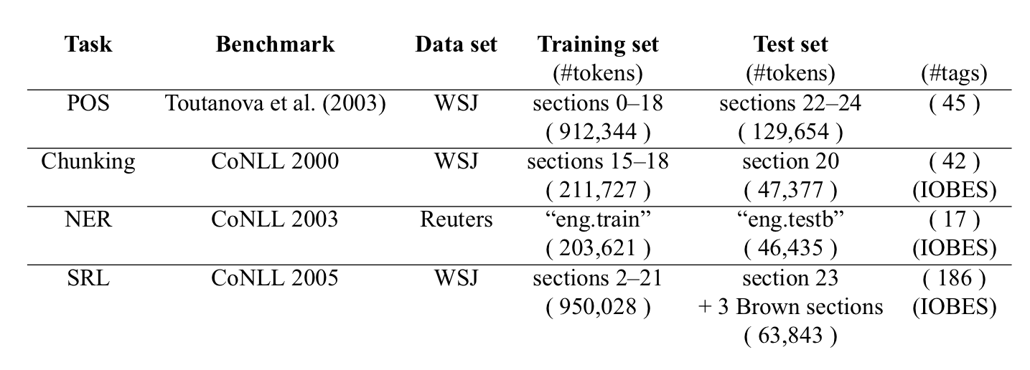
Benchmarks
Then for each one of the four areas,
we choose an ideal benchmark to use.
Why do we use a benchmark?
What is a benchmark?
What is an ideal benchmark?
How do we use a benchmark?

Slide 17
The Networks
Quick note on how the algorithm works:
Four tasks (POS, CHUNK, NER, SRL)
Two categories: Syntactic & Semantic
Four corresponding benchmarks to show the results
Multi-layer neural network
Common feature of all four tasks:

Slide 18
The Networks
Quick note on how the algorithm works:
Four tasks (POS, CHUNK, NER, SRL)
Two categories: Syntactic & Semantic
Four corresponding benchmarks to show the results
Multi-layer neural network
Common feature of all four tasks:
They are tasks assigning labels to words.

Slide 19
The Networks
Quick note on how the algorithm works:
Four tasks (POS, CHUNK, NER, SRL)
Two categories: Syntactic & Semantic
Four corresponding benchmarks to show the results
Multi-layer neural network
Common feature of all four tasks:
They are tasks assigning labels to words.
Tagging!

Slide 20
The networks
Traditional NLP approach:
· Extract from a rich set of hand-designed features which
are then fed to a standard classification algorithm
· The choice of features is a completely empirical process,
based on first linguistic intuition, and then trial and error
· The feature selection is task dependent, implying
additional research for each new NLP task
· More workload, less efficiency, (maybe) less accuracy

Slide 21
The networks
Traditional NLP approach:
· Extract from a rich set of hand-designed features which
are then fed to a standard classification algorithm
· The choice of features is a completely empirical process,
based on first linguistic intuition, and then trial and error
· The feature selection is task dependent, implying
additional research for each new NLP task
· More workload, less efficiency, (maybe) less accuracy
A radically different approach:
· As input we will try to pre-process our
features as little as possible
· Then use a multi-layer neural network
architecture, trained in an end-to-end
fashion

Slide 22
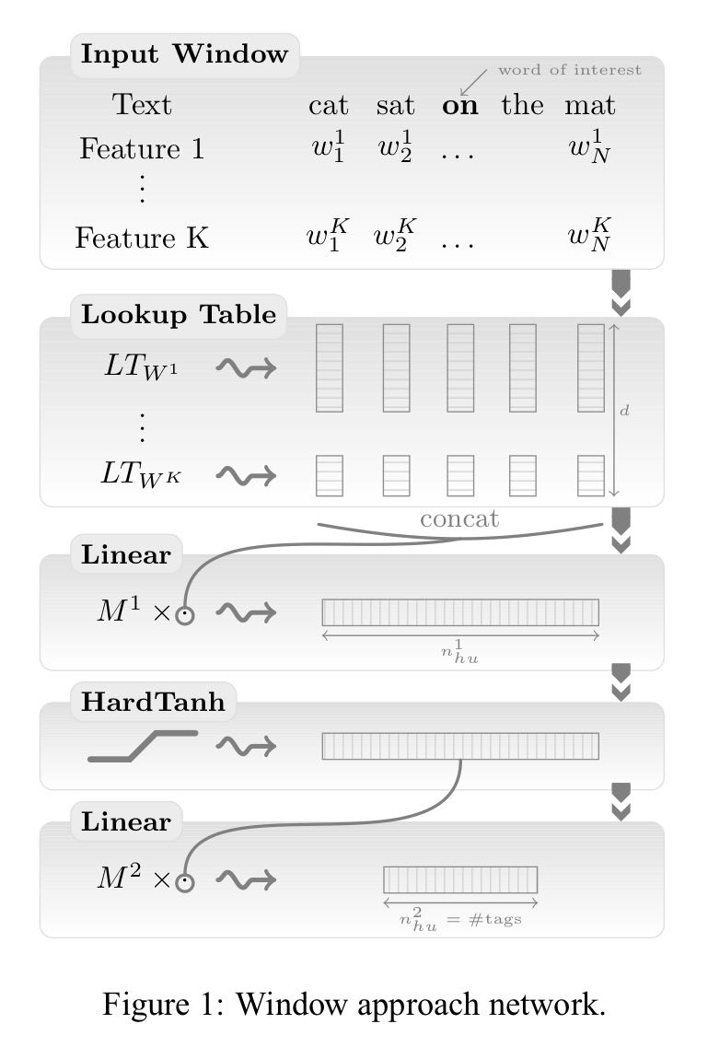
The networks
The first layer extracts features for each word.
The second layer extracts features from a window of words or from the
whole sentence, treating it as a sequence instead of a bag of words.
The following layers are standard Neural Network layers (DL)

Slide 23
The DL part
At the very start, how does our DL algorithm take data inputs?
After that, how are our neural networks trained?
In the broad picture, what is a multi-layer neural network?
Also, what is an end-to-end fashion?
At the end of the day, is our algorithm successful? Is there still ways to further improve it?

Slide 24
The DL part
Q1. At the very start, how does our DL algorithm take data inputs?
Remember, one of the key points of our architecture is its ability to perform well with the use of
RAW WORDS
For efficiency, words are fed to our architecture as indices taken from a finite dictionary D
Each of these word indices are mapped into a feature vector by a lookup table operation
BACKPROPAGATION
And that is why an end-to-end fashion is used! (Q4)

Slide 25
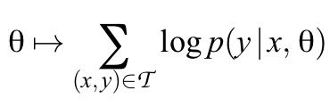
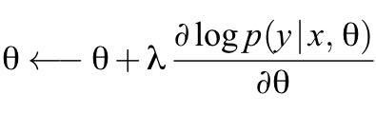
The DL part
Q2. After that, how are our neural networks trained?
All our neural networks are trained by maximizing a likelihood over the training data,
using stochastic gradient ascent.
Maximizing the likelihood
Using stochastic gradient ascent

Slide 26
The DL part
Q3. In the broad picture, what is a multi-layer neural network?
Multi-layer NN VS. Single-layer NN

Slide 27
The DL part
Q3. In the broad picture, what is a multi-layer neural network?
Multi-layer NN VS. Single-layer NN
A Multi-Layer Neural Network contains one or more hidden layers
(apart from one input and one output layer)
While a single layer perceptron can only learn linear functions
a multi-layer perceptron can also learn non – linear functions

Slide 28
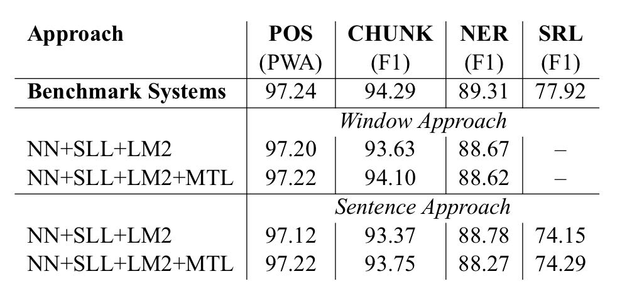
The DL part
Q5. At the end of the day, is our algorithm successful? Is there still ways to further improve it?
Multi-layer NN helps us produce a single unified network that performs well for all these tasks using the sentence approach.
However, the unified network only leads to marginal improvements over using a separate network for each task.

Slide 29
The DL part
Q5. At the end of the day, is our algorithm successful? Is there still ways to further improve it?
Any approaches to improve?
YES!
Remember we are using data to train
our model..
What we need is just LOTS OF UNLABELED DATA!
Incorporate previous NLP knowledge which
we have disregarded

Slide 30
Summary
Let’s come back to our initial point and think of this question:
Theoretically, in which aspects are we better than previous researchers, and why?

Slide 31
Summary
Let’s come back to our initial point and think of this question:
Theoretically, in which aspects are we better than previous researchers, and why?
1. Handle multi-tasks at a time -> Incorporating DL algorithm (Multi-layer NN)
2. Better speed -> Using simple input features and avoiding the nonnegligible computation time
associated with complex handcrafted features
3. Higher accuracy -> Avoiding empirical human work and adopting an end-to-end structure to
let the computer learn by itself

Slide 32
NLP from Scratch
Thanks!
Peiyang Song
CCS Computing, UCSB

